Slide 1
Exam One Study Guide
Dr. Helen Wei

Slide 2
Date and Time and Place
Date: Mar 3rd, 2021
Time: in class

Slide 3
Exam Format
Online based exam
90 minutes (Part I: multiple choice 30, Part II: free format 2 programming 1)
Open book and open notes

Slide 4
Question Types
Multiple Choice and True False (30)
Flexible Format(2)
Programming Question (1)

Slide 5
Knowledge Coverage
Object Oriented Concepts (Appendix a)– very small portion 5%
Chapter 1 ADT, Java Collections Framework, Generics – 30%
Chapter 2 Time Complexity, Big-O Notation, ArrayList and LinkedList– 65%

Slide 6
How to prepare for the exam
Go over the two course slides posted on the Blackboard → Course slides → ch01/ch02
Go over the three lab assignments, Understand what is the time complexity (big-O) notation for each algorithm

Slide 7
Appendix a Object Oriented Concepts
ADT
Data Structure
Abstract Data Type
Abstract Class
Interface
Generic Types
Java Collections Framework
Sub-Super class
Checked and unchecked exceptions
Etc.

Slide 8
Chapter 1

Slide 9
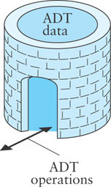
ADTs
Abstract Date Type (ADT)
An encapsulation of data and methods
Allows for reusable code
The user need not know about the implementation of the ADT
A user interacts with the ADT using only public methods
Notes:
fortress

Slide 10
ADTs (cont.)
ADTs facilitate storage, organization, and processing of information
Such ADTs often are called data structures
The Java Collections Framework provides implementations of common data structures

Slide 11
Interfaces
An interface specifies or describes an ADT to the applications programmer:
the methods and the actions that they must perform
what arguments, if any, must be passed to each method
what result the method will return
The interface can be viewed as a contract which guarantees how the ADT will function

Slide 12
Interfaces (cont.)
A class that implements the interface provides code for the ADT
As long as the implementation satisfies the ADT contract, the programmer may implement it as he or she chooses
In addition to implementing all data fields and methods in the interface, the programmer may add:
data fields not in the implementation
methods not in the implementation
constructors (an interface cannot contain constructors because it cannot be instantiated)

Slide 13
Object-Oriented Programming
Object-oriented programming (OOP) is popular because:
it enables reuse of previous code saved as classes
which saves times because previously written code has been tested and debugged already
If a new class is similar to an existing class, the existing class can be extended
This extension of an existing class is called inheritance

Slide 14
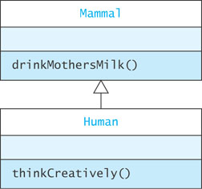
Inheritance
A Human is a Mammal
Human has all the data fields and methods defined by Mammal
Mammal is the superclass of Human
Human is a subclass of Mammal
Human may define other variables and methods that are not contained in Mammal

Slide 15
Inheritance (cont.)
Mammal has only method drinkMothersMilk()
Human has method drinkMothersMilk() and thinkCreatively()
Objects lower in the hierarchy are generally more powerful than their superclasses because of additional attributes

Slide 16

A Superclass and Subclass Example
Computer
A computer has a
manufacturer
processor
RAM
disk

Slide 17
A Superclass and Subclass Example (cont.)
Computer
A computer has
manufacturer
processor
RAM
disk
Computer
String manufacturer
String processor
int ramSize
int diskSize
double processorSpeed

Slide 18
A Superclass and Subclass Example (cont.)
Computer
String manufacturer
String processor
int ramSize
int diskSize
double processorSpeed
int getRamSize()
int getDiskSize()
double getProcessorSpeed()
Double computePower()
String toString()

Slide 19
The No-Parameter Constructor
If the execution of any constructor in a subclass does not invoke a superclass constructor—an explicit call to super()—Java automatically invokes the no-parameter constructor for the superclass
If no constructors are defined for a class, the no-parameter constructor for that class is provided by default
However, if any constructors are defined, you must explicitly define a no-parameter constructor

Slide 20
Protected Visibility for Superclass Data Fields
Variables with private visibility cannot be accessed by a subclass
Variables with protected visibility (defined by the keyword protected) are accessible by any subclass or any class in the same package
In general, it is better to use private visibility and to restrict access to variables to accessor methods

Slide 21
Abstract Classes
An abstract class is denoted by using the word abstract in its heading:
visibility abstract class className
An abstract class differs from an actual class (sometimes called a concrete class) in two respects:
• An abstract class cannot be instantiated
• An abstract class may declare abstract methods
Just as in an interface, an abstract method is declared through a method heading:
visibility abstract resultType methodName (parameterList);
An actual class that is a subclass of an abstract class must provide an implementation for each abstract method

Slide 22
Abstract Classes (cont.)
Use an abstract class in a class hierarchy when you need a base class for two or more subclasses that share some attributes
You can declare some or all of the attributes and define some or all of the methods that are common to these subclasses
You can also require that the actual subclasses implement certain methods by declaring these methods abstract

Slide 23
Example of an Abstract Class
public abstract class Food {
public final String name;
private double calories;
// Actual methods
public double getCalories () {
return calories;
}
protected Food (String name, double calories) {
this.name = name;
this.calories = calories;
}
// Abstract methods
public abstract double percentProtein();
public abstract double percentFat();
public abstract double percentCarbs();
}

Slide 24
Interfaces, Abstract Classes, and Concrete Classes
A Java interface can declare methods,but cannot implement them
Methods of an interface are called abstract methods.
An abstract class can have:
abstract methods (no body)
concrete methods (with a body)
data fields
Unlike a concrete class, an abstract class
cannot be instantiated
can declare abstract methods which must be implemented in all concrete subclasses

Slide 25
Abstract Classes and Interfaces
Abstract classes and interfaces cannot be instantiated
An abstract class can have constructors!
Purpose: initialize data fields when a subclass object is created
The subclass uses super(…) to call the constructor
An abstract class may implement an interface, but need not define all methods of the interface
Implementation is left to subclasses

Slide 26
Inheriting from Interfaces vs Classes
A class can extend 0 or 1 superclass
An interface cannot extend a class
A class or interface can implement 0 or more interfaces

Slide 27
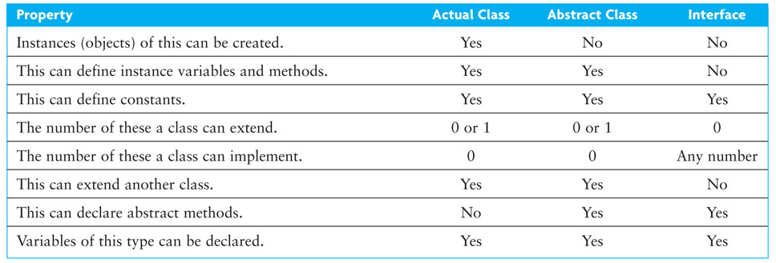
Summary of Features of Actual Classes, Abstract Classes, and Interfaces

Slide 28
Run-time Errors or Exceptions
Run-time errors
occur during program execution (i.e. at run-time)
occur when the JVM detects an operation that it knows to be incorrect
cause the JVM to throw an exception
Examples of run-time errors include
division by zero
array index out of bounds
number format error
null pointer exception

Slide 29
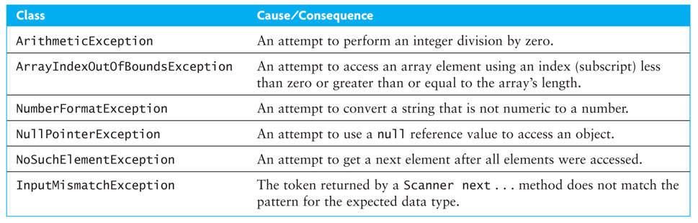
Run-time Errors or Exceptions (cont.)

Slide 30
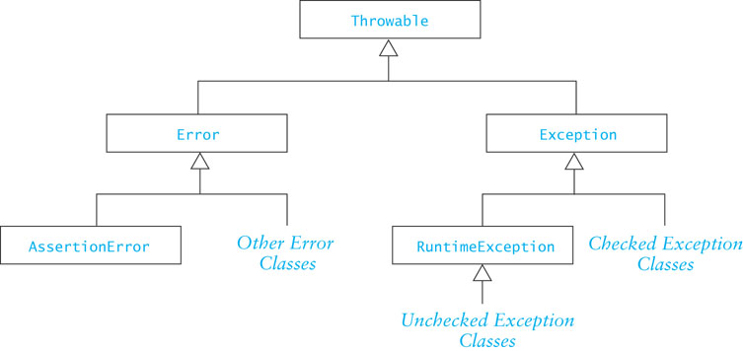
Class Throwable
Throwable is the superclass of all exceptions
All exception classes inherit its methods

Slide 31
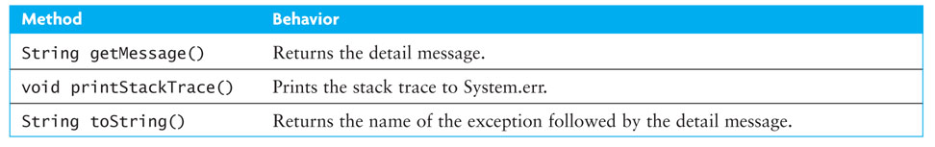
Class Throwable (cont.)
Throwable has several useful methods that are available to all of its subclasses

Slide 32
Checked and Unchecked Exceptions
Checked exceptions
normally not due to programmer error
generally beyond the control of the programmer
all input/output errors are checked exceptions
Examples: IOException, FileNotFoundException
Unchecked exceptions result from
programmer error (try to prevent them with defensive programming).
a serious external condition that is unrecoverable
Examples: NullPointerException, ArrayIndexOutOfBoundsException

Slide 33
Checked and Unchecked Exceptions (cont.)
The class Error and its subclasses represent errors due to serious external conditions; they are unchecked
Example: OutOfMemoryError
You cannot foresee or guard against them
While you can attempt to handle them, it is generally not a good idea as you will probably be unsuccessful
The class Exception and its subclasses can be handled by a program
RuntimeException and its subclasses are unchecked
All others must be either:
explicitly caught or
explicitly mentioned as thrown by the method

Slide 34
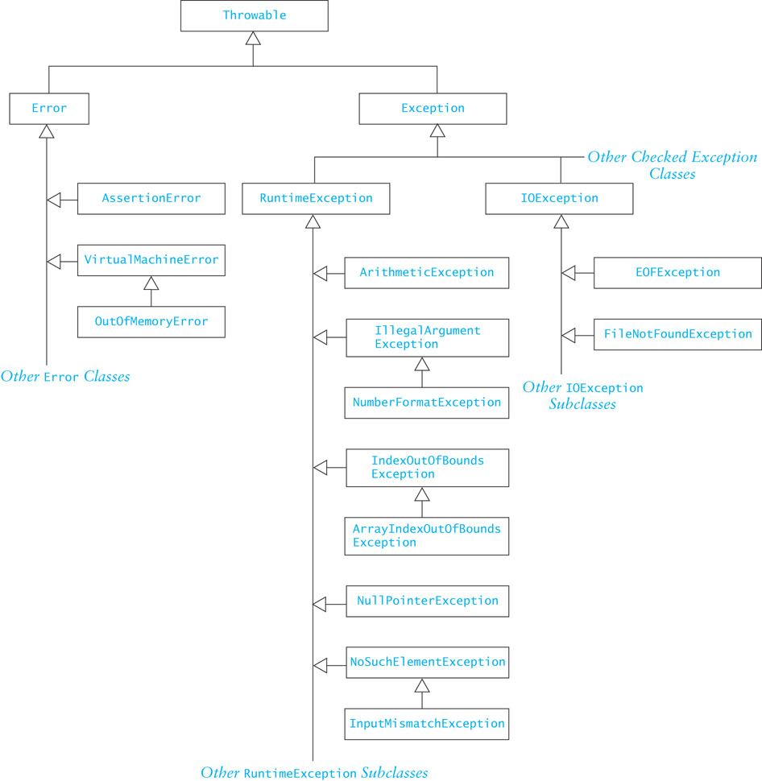
Checked and Unchecked Exceptions (cont.)

Slide 35
Some Common Unchecked Exceptions
ArithmeticException: division by zero, etc.
ArrayIndexOutOfBoundsException
NumberFormatException: converting a “bad” string to a number
NullPointerException
NoSuchElementException: no more tokens available

Slide 36
Packages
A Java package is a group of cooperating classes
The Java API is organized as packages
Indicate the package of a class at the top of the file:
package classPackage;
Classes in the same package should be in the same directory (folder)
The folder must have the same name as the package
Classes in the same folder must be
in the same package

Slide 37
Packages and Visibility
Classes not part of a package can only access public members of classes in the package
If a class is not part of the package, it must access the public classes by their complete name, which would be packagename.className
For example,
x = Java.awt.Color.GREEN;
If the package is imported, the packageName prefix is not required.
import java.awt.Color;
...
x = Color.GREEN;

Slide 38
The Default Package
Files which do not specify a package are part of the default package
If you do not declare packages, all of your classes belong to the default package
The default package is intended for use during the early stages of implementation or for small prototypes
When you develop an application, declare its classes to be in the same package

Slide 39
Visibility
You know about three visibility layers, public, protected, private
A fourth layer, package visibility, lies between private and protected
Classes, data fields, and methods with package visibility are accessible to all other methods of the same package, but are not accessible to methods outside the package
Classes, data fields, and methods that are declared protected are visible within subclasses that are declared outside the package (in addition to being visible to all members inside the package)
There is no keyword to indicate package visibility
Package visibility is the default in a package if public, protected, private are not used

Slide 40
Visibility Supports Encapsulation
Visibility rules enforce encapsulation in Java
private: for members that should be invisible even in subclasses
package: shields classes and members from classes outside the package
protected: provides visibility to extenders of classes in the package
public: provides visibility to all

Slide 41
Packages
A Java package is a group of cooperating classes
The Java API is organized as packages
Indicate the package of a class at the top of the file:
package classPackage;
Classes in the same package should be in the same directory (folder)
The folder must have the same name as the package
Classes in the same folder must be
in the same package

Slide 42
Packages and Visibility
Classes not part of a package can only access public members of classes in the package
If a class is not part of the package, it must access the public classes by their complete name, which would be packagename.className
For example,
x = Java.awt.Color.GREEN;
If the package is imported, the packageName prefix is not required.
import java.awt.Color;
...
x = Color.GREEN;

Slide 43
The Default Package
Files which do not specify a package are part of the default package
If you do not declare packages, all of your classes belong to the default package
The default package is intended for use during the early stages of implementation or for small prototypes
When you develop an application, declare its classes to be in the same package

Slide 44
Visibility
You know about three visibility layers, public, protected, private
A fourth layer, package visibility, lies between private and protected
Classes, data fields, and methods with package visibility are accessible to all other methods of the same package, but are not accessible to methods outside the package
Classes, data fields, and methods that are declared protected are visible within subclasses that are declared outside the package (in addition to being visible to all members inside the package)
There is no keyword to indicate package visibility
Package visibility is the default in a package if public, protected, private are not used

Slide 45
Visibility Supports Encapsulation
Visibility rules enforce encapsulation in Java
private: for members that should be invisible even in subclasses
package: shields classes and members from classes outside the package
protected: provides visibility to extenders of classes in the package
public: provides visibility to all

Slide 46
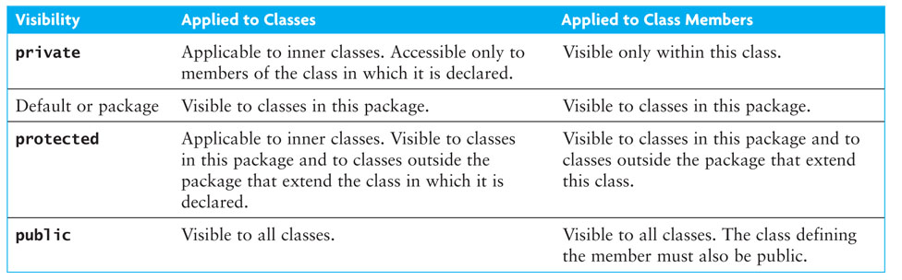
Visibility Supports Encapsulation (cont.)

Slide 47
Visibility Supports Encapsulation (cont.)
Encapsulation insulates against change
Greater visibility means less encapsulation
So… use the most restrictive visibility possible to get the job done!

Slide 48
Generic Collections
The statement
List<String> myList = new ArrayList<String>();
uses a language feature called generic collections or generics
The statement creates a List of String; only references of type String can be stored in the list
String in this statement is called a type parameter
The type parameter sets the data type of all objects stored in a collection

Slide 49
Generic Collections (cont.)
The general declaration for generic collection is
CollectionClassName<E> variable = new CollectionClassName<E>();
The <E> indicates a type parameter
Adding a noncompatible type to a generic collection will generate an error during compile time
However, primitive types will be autoboxed:
ArrayList<Integer> myList = new ArrayList<Integer>();
myList.add(new Integer(3)); // ok
myList.add(3); // also ok! 3 is automatically wrapped
in an Integer object
myList.add(new String("Hello")); // generates a type incompatability error

Slide 50
Why Use Generic Collections?
Better type-checking: catch more errors, catch them earlier
Documents intent
Avoids the need to downcast from Object

Slide 51
Chapter 2

Slide 52
Algorithm Efficiency and Big-O
Getting a precise measure of the performance of an algorithm is difficult
Big-O notation expresses the performance of an algorithm as a function of the number of items to be processed
This permits algorithms to be compared for efficiency
For more than a certain number of data items, some problems cannot be solved by any computer

Slide 53
Big-O Notation
The O() in the previous examples can be thought of as an abbreviation of "order of magnitude"
A simple way to determine the big-O notation of an algorithm is to look at the loops and to see whether the loops are nested
Assuming a loop body consists only of simple statements,
a single loop is O(n)
a pair of nested loops is O(n²)
a nested pair of loops inside another is O(n³)
and so on . . .

Slide 54
Big-O Notation (cont.)
You must also examine the number of times a loop is executed
for(i=1; i < x.length; i *= 2) {
// Do something with x[i]
}
The loop body will execute k-1 times, with i having the following values: 1, 2, 4, 8, 16, . . ., 2^{k} until 2^{k} is greater than x.length
Since 2^{k-1} = x.length < 2^{k} and log₂2^{k} is k, we know that k-1 = log₂(x.length) < k
Thus we say the loop is O(log n) (in analyzing algorithms, we use logarithms to the base 2)
Logarithmic functions grow slowly as the number of data items n increases

Slide 55
Formal Definition of Big-O (cont.)
In terms of T(n),
T(n) = O(f(n))
There exist
two constants, n₀ and c, greater than zero, and
a function, f(n),
such that for all n > n₀, cf(n) = T(n)
In other words, as n gets sufficiently large (larger than n₀), there is some constant c for which the processing time will always be less than or equal to cf(n)
cf(n) is an upper bound on performance

Slide 56
Formal Definition of Big-O (cont.)
The growth rate of f(n) will be determined by the fastest growing term, which is the one with the largest exponent
In the example, an algorithm of
O(n² + 5n + 25)
is more simply expressed as
O(n²)
In general, it is safe to ignore all constants and to drop the lower-order terms when determining the order of magnitude

Slide 57
Big-O Example 1
Given T(n) = n² + 5n + 25, show that this is O(n²)
Find constants n₀ and c so that, for all n > n₀, cn² > n² + 5n + 25
Find the point where cn² = n² + 5n + 25
Let n = n₀, and solve for c
c = 1 + 5/ n₀, + 25/ n₀ ²
When n₀ is 5(1 + 5/5 + 25/25), c is 3
So, 3n² > n² + 5n + 25 for all n > 5
Other values of n₀ and c also work

Slide 58
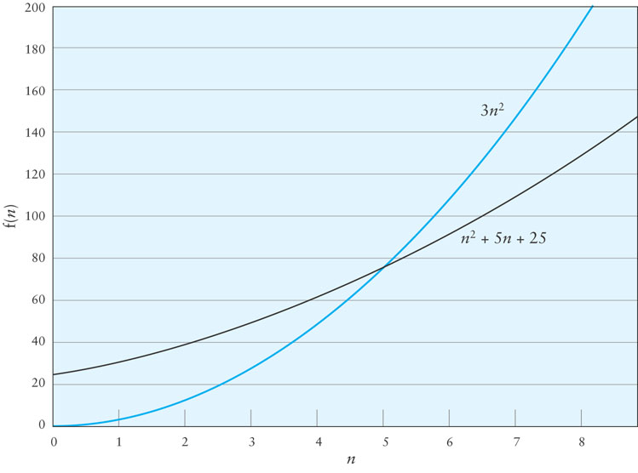
Big-O Example 1 (cont.)

Slide 59
Big-O Example 2
Consider the following loop
for (int i = 0; i < n; i++) {
for (int j = i + 1; j < n; j++) {
3 simple statements
}
}
T(n) = 3(n – 1) + 3 (n – 2) + … + 3
Factoring out the 3,
3(n – 1 + n – 2 + n – 3 + … + 1)
1 + 2 + … + n – 1 = (n x (n-1))/2

Slide 60
Big-O Example 2 (cont.)
Therefore T(n) = 1.5n² – 1.5n
When n = 0, the polynomial has the value 0
For values of n > 1, 1.5n² > 1.5n² – 1.5n
Therefore T(n) is O(n²) when n₀ is 1 and c is 1.5

Slide 61
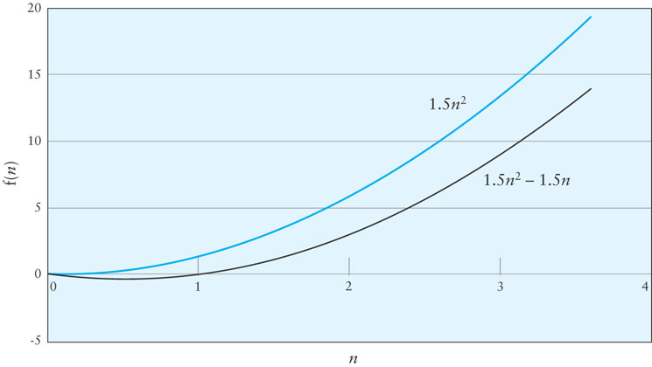
Big-O Example 2 (cont.)

Slide 62
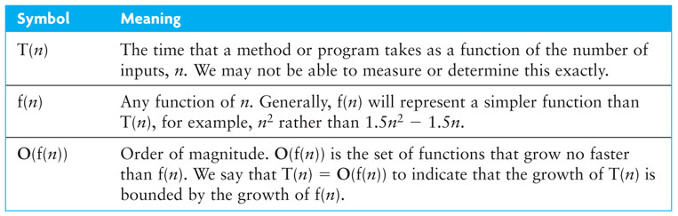
Symbols Used in Quantifying Performance

Slide 63
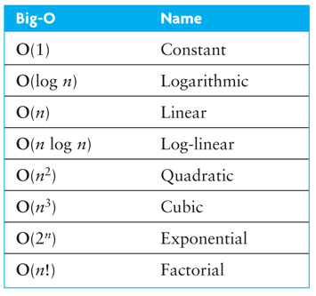
Common Growth Rates

Slide 64
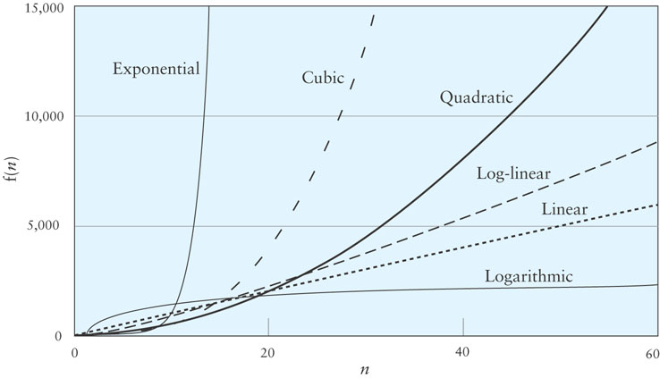
Different Growth Rates

Slide 65
ArrayList Class
The simplest class that implements the List interface
An improvement over an array object
Use when:
you will be adding new elements to the end of a list
you need to access elements quickly in any order

Slide 66
ArrayList Class (cont.)
To declare a List “object” whose elements will reference String objects:
List<String> myList = new ArrayList<String>();
The initial List is empty and has a default initial capacity of 10 elements
To add strings to the list,
myList.add("Bashful");
myList.add("Awful");
myList.add("Jumpy");
myList.add("Happy");

Slide 67
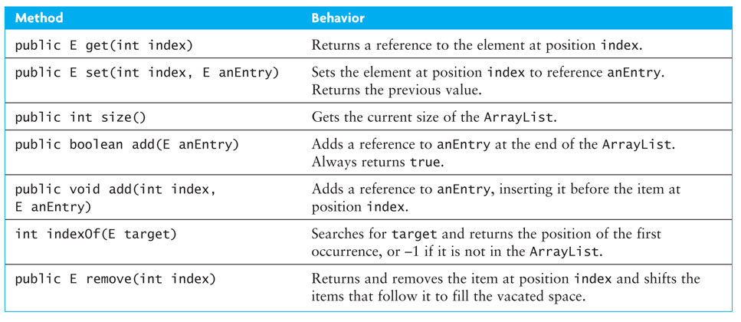
Specification of the ArrayList Class

Slide 68
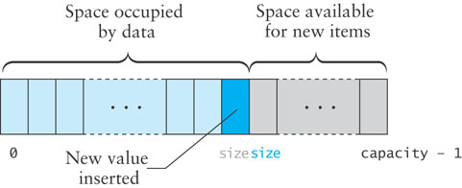
Implementing ArrayList.add(E)(cont.)
If size is less than capacity, then to append a new item
insert the new item at the position indicated by the value of size
increment the value of size
return true to indicate successful insertion

Slide 69
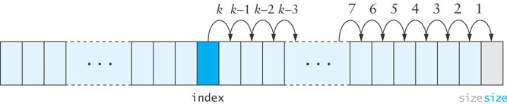
Implementing ArrayList.add(int index,E anEntry)
To insert into the middle of the array, the values at the insertion point are shifted over to make room, beginning at the end of the array and proceeding in the indicated order

Slide 70
Implementing ArrayList.add(index,E)
public void add (int index, E anEntry) {
// check bounds
if (index < 0 || index > size) {
throw new ArrayIndexOutOfBoundsException(index);
}
// Make sure there is room
if (size >= capacity) {
reallocate();
}
// shift data
for (int i = size; i > index; i--) {
theData[i] = theData[i-1];
}
// insert item
theData[index] = anEntry;
size++;
}

Slide 71
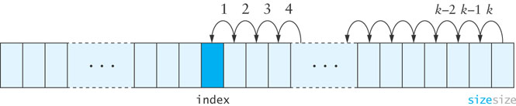
remove Method
When an item is removed, the items that follow it must be moved forward to close the gap
Begin with the item closest to the removed element and proceed in the indicated order

Slide 72
remove Method (cont.)
public E remove (int index) {
if (index < 0 || index >= size) {
throw new ArrayIndexOutOfBoundsException(index);
}
E returnValue = theData[index];
for (int i = index + 1; i < size; i++) {
theData[i-1] = theData[i];
}
size--;
return returnValue;
}

Slide 73
reallocate Method
Create a new array that is twice the size of the current array and then copy the contents of the new array
private void reallocate () {
capacity *= 2;
theData = Arrays.copyOf(theData, capacity);
}

Slide 74
Single-Linked Lists
A linked list is useful for inserting and removing at arbitrary locations
The ArrayList is limited because its add and remove methods operate in linear (O(n)) time—requiring a loop to shift elements
A linked list can add and remove elements at a known location in O(1) time
In a linked list, instead of an index, each element is linked to the following element

Slide 75
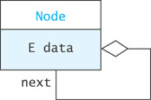
A List Node
A node can contain:
a data item
one or more links
A link is a reference to a list node
In our structure, the node contains a data field named data of type E
and a reference to the next node, named next

Slide 76
List Nodes for Single-Linked Lists
private static class Node<E> {
private E data;
private Node<E> next;
/** Creates a new node with a null next field
@param dataItem The data stored
*/
private Node(E dataItem) {
data = dataItem;
next = null;
}
/** Creates a new node that references another node
@param dataItem The data stored
@param nodeRef The node referenced by new node
*/
private Node(E dataItem, Node<E> nodeRef) {
data = dataItem;
next = nodeRef;
}
}

Slide 77
List Nodes for Single-Linked Lists (cont.)
private static class Node<E> {
private E data;
private Node<E> next;
/** Creates a new node with a null next field
@param dataItem The data stored
*/
private Node(E data) {
data = dataItem;
next = null;
}
/** Creates a new node that references another node
@param dataItem The data stored
@param nodeRef The node referenced by new node
*/
private Node(E dataItem, Node<E> nodeRef) {
data = dataItem;
next = nodeRef;
}
}
The keyword static indicates that the Node<E> class will not reference its outer class
Static inner classes are also called nested classes

Slide 78
List Nodes for Single-Linked Lists (cont.)
private static class Node<E> {
private E data;
private Node<E> next;
/** Creates a new node with a null next field
@param dataItem The data stored
*/
private Node(E dataItem) {
data = dataItem;
next = null;
}
/** Creates a new node that references another node
@param dataItem The data stored
@param nodeRef The node referenced by new node
*/
private Node(E dataItem, Node<E> nodeRef) {
data = dataItem;
next = nodeRef;
}
}
Generally, all details of the Node class should be private. This applies also to the data fields and constructors.

Slide 79
Connecting Nodes (cont.)
Node<String> tom = new Node<String>("Tom");
Node<String> dick = new Node<String>("Dick");
Node<String> harry = new Node<String>("Harry");
Node<String> sam = new Node<String>("Sam");
tom.next = dick;
dick.next = harry;
harry.next = sam;

Slide 80
A Single-Linked List Class
Generally, we do not have individual references to each node.
A SingleLinkedList object has a data field head, the list head, which references the first list node
public class SingleLinkedList<E> {
private Node<E> head = null;
private int size = 0;
...
}

Slide 81
SLList: An Example List
SLList<String>
Node<String>
Node<String>
head =
next =
data = "Tom"
next =
data = "Dick"

Slide 82
Implementing SLList.addFirst(E item)
SLList<String>
Node<String>
Node<String>
head =
next =
data = "Tom"
next =
data = "Dick"
Node<String>
next =
data = "Ann"
The element added to the list

Slide 83
Implementing SLList.addFirst(E item) (cont.)
private void addFirst (E item) {
Node<E> temp = new Node<E>(item, head);
head = temp;
size++;
}
or, more simply ...
private void addFirst (E item) {
head = new Node<E>(item, head);
size++;
}
This works even if head is null

Slide 84
Implementing addAfter(Node<E> node, E item)
SLList<String>
Node<String>
Node<String>
head =
next =
data = "Tom"
next =
data = "Dick"
Node<String>
next =
data = "Ann"
The element added to the list

Slide 85
Implementing addAfter(Node<E> node, E item) (cont.)
private void addAfter (Node<E> node, E item) {
Node<E> temp = new Node<E>(item, node.next);
node.next = temp;
size++;
}
or, more simply ...
private void addAfter (Node<E> node, E item) {
node.next = new Node<E>(item, node.next);
size++;
}
We declare this method private since it should not be called from outside the class. Later we will see how this method is used to implement the public add methods.

Slide 86
Implementing removeAfter(Node<E> node)
temp
SLList<String>
Node<String>
Node<String>
head =
next =
data = "Tom"
next =
data = "Dick"
Node<String>
The Node parameter
next =
data = "Ann"

Slide 87
Implementing removeAfter(Node<E> node) (cont.)
private E removeAfter (Node<E> node) {
Node<E> temp = node.next;
if (temp != null) {
node.next = temp.next;
size--;
return temp.data;
} else {
return null;
}
}

Slide 88
Implementing SLList.removeFirst()
SLList<String>
Node<String>
head =
next =
data = "Dick"
Node<String>
next =
data = "Tom"
temp

Slide 89
Implementing SLList.removeFirst() (cont.)
private E removeFirst () {
Node<E> temp = head;
if (head != null) {
head = head.next;
}
if (temp != null) {
size--;
return temp.data
} else {
return null;
}
}

Slide 90
Traversing a Single-Linked List
SLList<String>
Node<String>
Node<String>
head =
next =
data = "Tom"
next =
data = "Dick"
Do something with nodeRef
Do something with nodeRef
Do something with nodeRef
Node<String>
nodeRef
next =
data = "Ann"
null

Slide 91
Traversing a Single-Linked List (cont.)
toString()can be implemented with a traversal:
public String toString() {
Node<String> nodeRef = head;
StringBuilder result = new StringBuilder();
while (nodeRef != null) {
result.append(nodeRef.data);
if (nodeRef.next != null) {
result.append(" ==> ");
}
nodeRef = nodeRef.next;
}
return result.toString();
}

Slide 92
SLList.getNode(int)
In order to implement methods required by the List interface, we need an additional helper method:
private Node<E> getNode(int index) {
Node<E> node = head;
for (int i=0; i<index && node != null; i++) {
node = node.next;
}
return node;
}

Slide 93
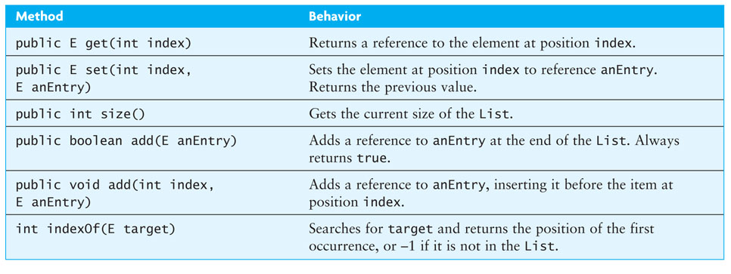
Completing the SingleLinkedList Class

Slide 94
Iterator Interface (cont.)
In the following loop, we process all items in List<Integer> through an Iterator
Iterator<Integer> iter = aList.iterator();
while (iter.hasNext()) {
int value = iter.next();
// Do something with value
...
}

Slide 95
Iterators and Removing Elements
You can use the Iterator remove()method to remove items from a list as you access them
remove() deletes the most recent element returned
You must call next()before each remove(); otherwise, an IllegalStateException will be thrown
LinkedList.remove vs. Iterator.remove:
LinkedList.remove must walk down the list each time, then remove, so in general it is O(n²)
Iterator.remove removes items without starting over at the beginning, so in general it is O(n)

Slide 96
Iterators and Removing Elements (cont.)
To remove all elements from a list of type Integer that are divisible by a particular value:
public static void removeDivisibleBy(LinkedList<Integer> aList, int div) {
Iterator<Integer> iter = aList.iterator();
while (iter.hasNext()) {
int nextInt = iter.next();
if (nextInt % div == 0) {
iter.remove();
}
}
}

Slide 97
ListIterator Interface
Iterator limitations
Traverses List only in the forward direction
Provides a remove method, but no add method
You must advance the Iterator using your own loop if you do not start from the beginning of the list
ListIterator extends Iterator, overcoming these limitations

Slide 98
Good Luck!

